Slide 1
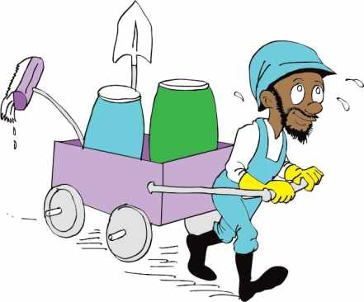
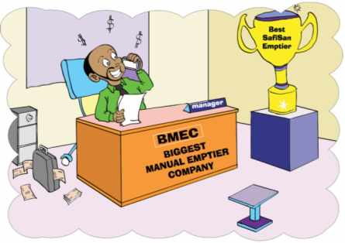
UBSUP Financing & Business Model
Sanitation is Business

Slide 2
Definitions
FINANCING MODEL:
Describes the infrastructure development phase and the flow of money
BUSINESS MODEL:
Describes business opportunities within the SafiSan programme

Slide 3
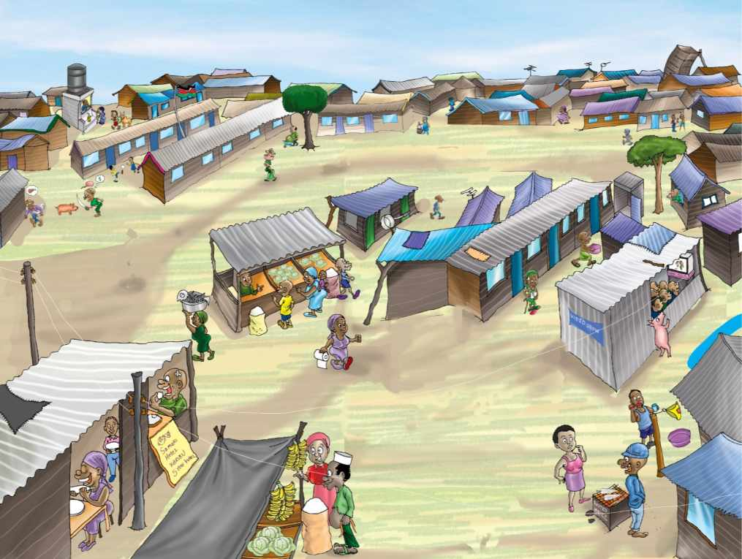





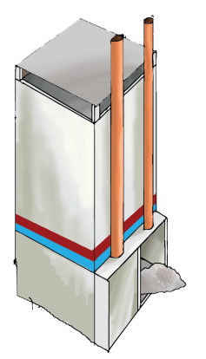

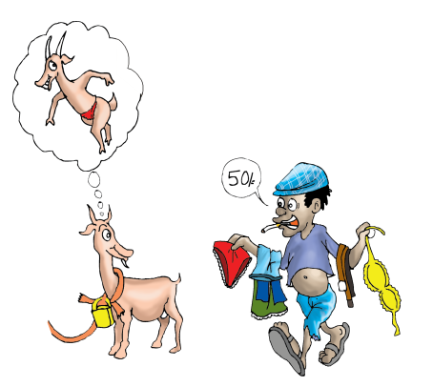
Infrastructure Development
Business Opportunities
Presentation Outline

Slide 4

(2) SafiSan Implementation – The Financing Model

Slide 5





Step 1: Project Preparation
Call for Proposals
Application for project funding
(3) Fund disbursement
(4) Training & Certification
(5) Recruitment
& Training

Slide 6


Step 2: Providing Toilets
(7) Placing of
order & payment
(6) Marketing of SafiSan
(6) Promotion of SafiSan
(8) Construction
of facility

Slide 7
Step 3: Requesting for the PCI
(11) Application &
Payment of PCI
(10a) Application &
Payment of PCI
(9) Final
inspection
OR
(10b) Application &
Payment of PCI
Post Construction Incentive (PCI) will either be paid to the Artisan OR to the Landlord depending on the selection made in the application form.

Slide 8
Key Considerations before PCI is paid out
The toilet has to be constructed according to the drawings provided
  If it’s a flush toilet, it should be connected to a septic tank or an existing sewer
  If it is a UDDT, the vault should be constructed well in order to hold the waste
  The quality of the toilet should be good and up to standard
The toilet has to have a hand-washing facility
Posters on toilet use and maintenance should be provided
Information on the plot and the owner must be filled out in the SafisApp
The WSP technical team has to approve the construction of the toilet in the SafisApp

Slide 9

(3) Stakeholders’ Involvement

Slide 10
Water Sector Trust Fund (WSTF)
TASKS
Fund relevant project activities
Provide technical assistance through County Resident Monitors
Provide drawings, concepts, tools, training materials, etc.
Monitor stakeholders’ performance
Build capacities
Promote SafiSan nationwide
Report to donors
Audit funded projects
Monitor operation of infrastructures

Slide 11
Water Service Providers (WSP)
TASKS
Establish multi-stakeholder Project Task Team
Hire sanitation marketers
Cooperate with WSTF County Resident Monitors
Implement project
Carefully manage funds
Report progress
Manage toilet emptying / service providers
Manage treatment facility
Provide customer services
Manage potential re-use
Promote SafiSan

Slide 12
Landladies & Landlords
ACTIVITIES & RESPONSIBILITIES
Sign up with the SafiSan programme
Select only certified artisans / emptiers
Agree on terms and conditions
Keep an eye on construction & emptying
Report bad service provision to the WSP
Pay for the subsidized toilet
Ensure proper use of the toilet
Facilitate the emptying process (e.g. give access to toilet)
Enjoy improved sanitation
Promote SafiSan
Provide feedback on SafiSan toilets (customer experience)

Slide 13
Public Health Officers, Group & Opinion Leaders
RESPONSIBILITIES & TASKS
Participate in the project task team
Promote SafiSan
Participate in project activities
Inform WSPs about legal issues regarding sanitation
Report lack of progress & poor quality of works
Report poor service provision
Report illegal dumping of waste
Further promote improved sanitation
Report any irregularities related to the programme
Register complaints at the WSP

Slide 14
Private Sector
TASKS
Continuously promote services
Maintain close contact to WSP and customers
Offer services to clients
Agree with landlords on terms and condition
Ensure high quality and reliable service
Expand your business
Promote SafiSan
Give feedback on designs & customer experiences

Slide 15

Stakeholders’ cooperation
tasks
monitoring
fund
implement
construct
empty
promote
pay / use

Slide 16

(4) LANDLORDS: How to get a Toilet?

Slide 17
LANDLORDS: How to get a toilet?
(6) Approves toilet
(8) Request
& pay PCI*
(1) Signs up
(2) Provides
information
(5) Reports
to WSP
(8) Request
& pay
PCI*
(3) Contracts artisan
*PCI can only be requested by one party
(7) Pays artisan
(4) Builds toilet

Slide 18
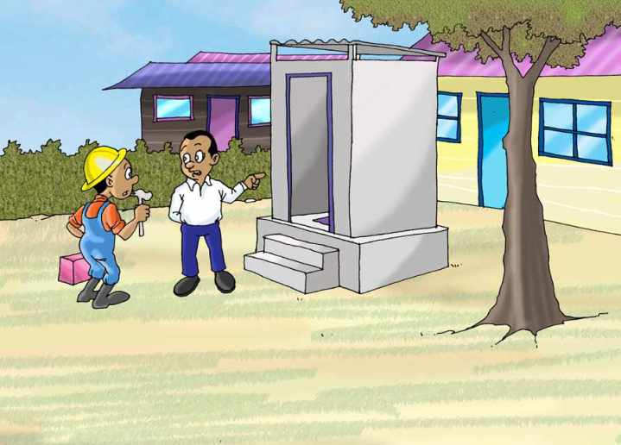
(5) Selected Business Models

Slide 19
ARTISANS: How to build toilets?
(7) Approve toilet
Apply for certification
(2) Train & certify artisan
(6) Inform WSP
(10) Pay PCI*
(5) Construct
toilets
(9) Apply for PCI*
(12) Construct
more toilets
(11) Promote further business
(8) Pay toilets
(4) Order toilets
(3) Promote services
* If eligible

Slide 20
EMPTIER: How to empty toilets?
Apply for certification
(5) Empty toilet
(2) Train & certify emptier
(7) Promote further services
(8) Provide more services
(6) Pay services
(4) Order services
(3) Promote
services

Slide 21
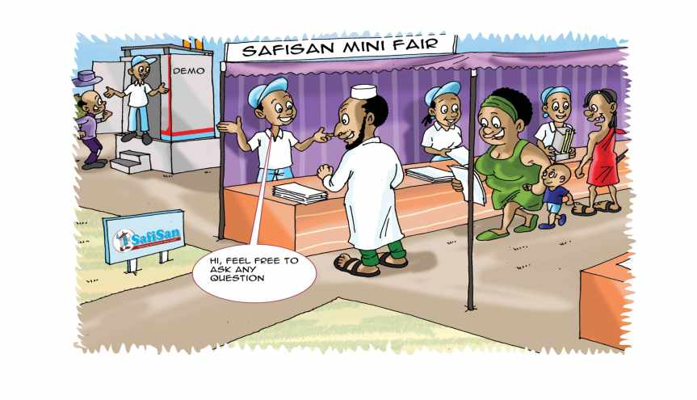
(6) Questions & Answers

